Slide 1
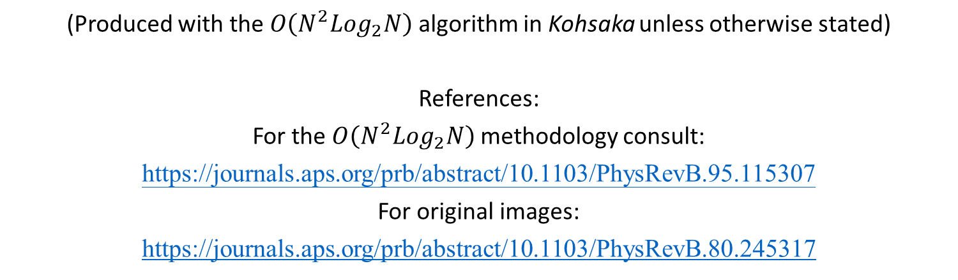
QPI Images
(Produced with the $O\left(N^{2}Log_{2}N\right)$algorithm in Kohsaka unless otherwise stated)
References:
For the $O\left(N^{2}Log_{2}N\right)$ methodology consult:
https://journals.aps.org/prb/abstract/10.1103/PhysRevB.95.115307
For original images:
https://journals.aps.org/prb/abstract/10.1103/PhysRevB.80.245317

Slide 2
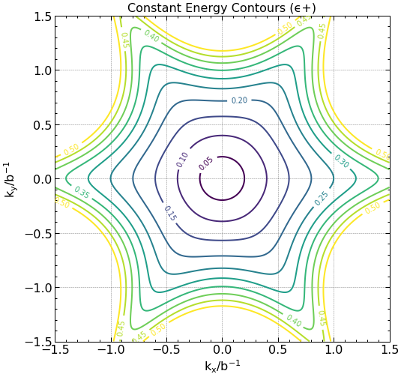
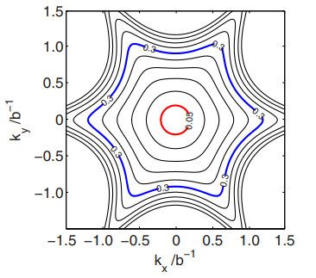
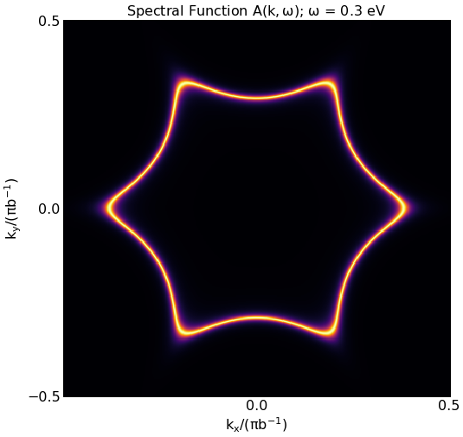
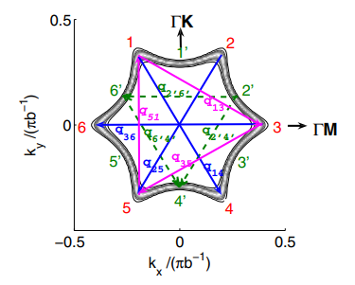
Figure (1) (Reproduction vs. original paper.)
Figure (2)

Slide 3
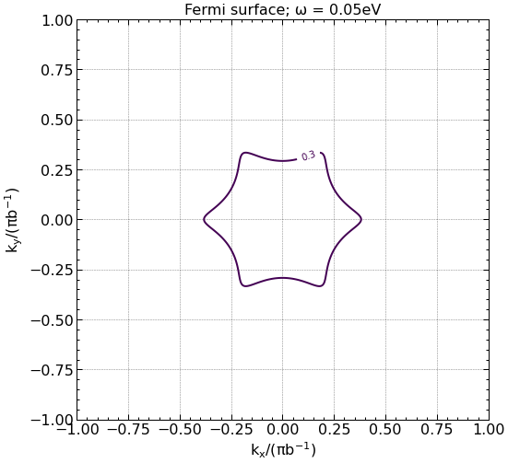
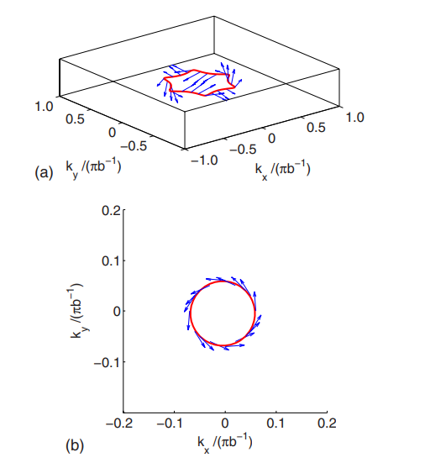

Fig. (3)

Slide 4
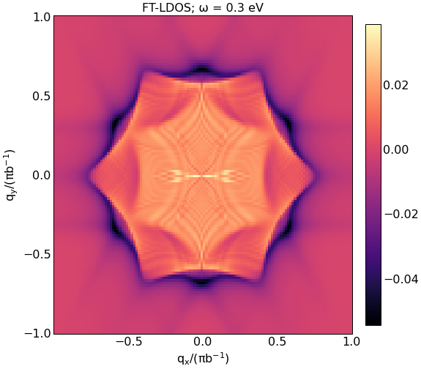
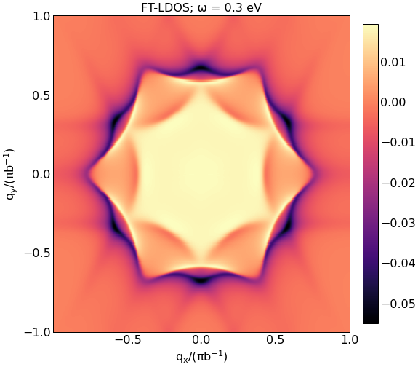
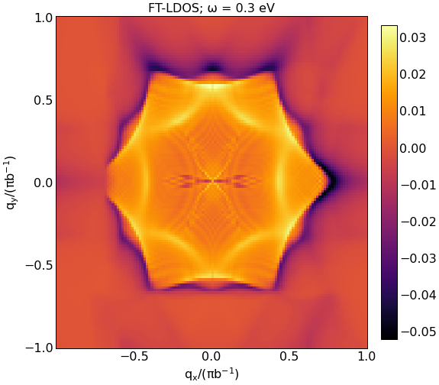
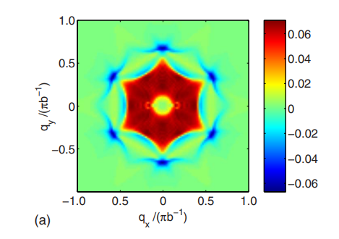
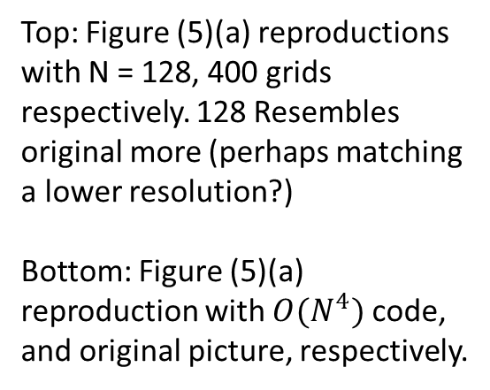
Top: Figure (5)(a) reproductions with N = 128, 400 grids respectively. 128 Resembles original more (perhaps matching a lower resolution?)
Bottom: Figure (5)(a) reproduction with $O(N^{4})$ code, and original picture, respectively.

Slide 5
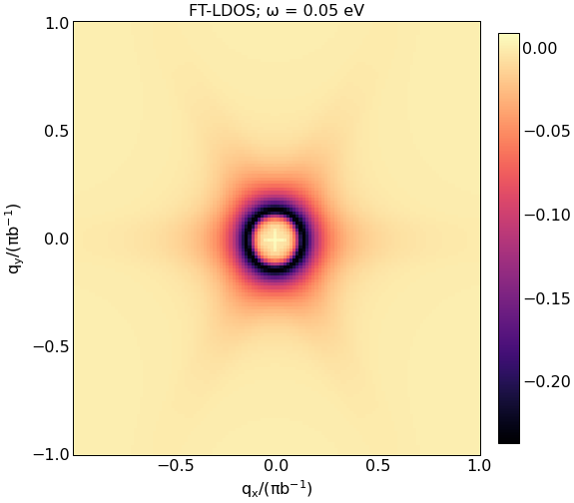
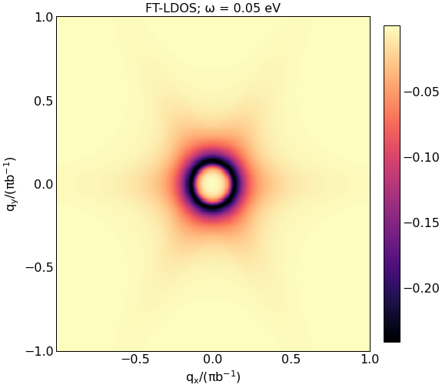
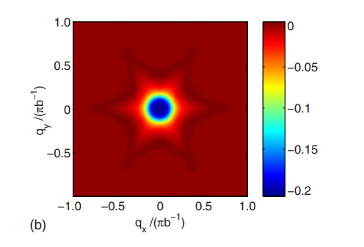
Top: Figure (5)(b) reproductions with N = 128, 400 grids respectively.
Bottom: Original Figure (5)(b).

Slide 6
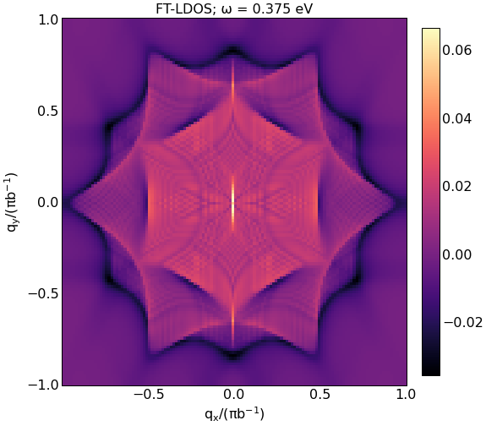
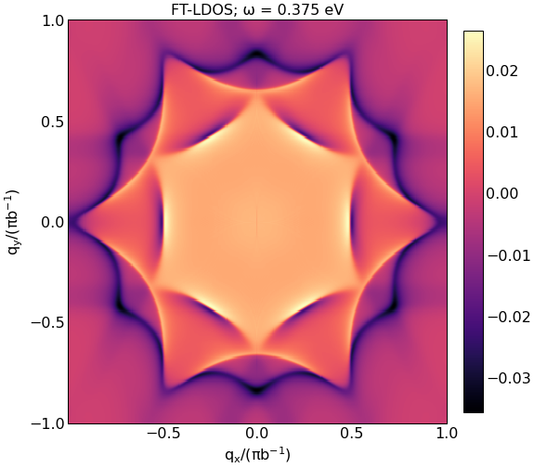
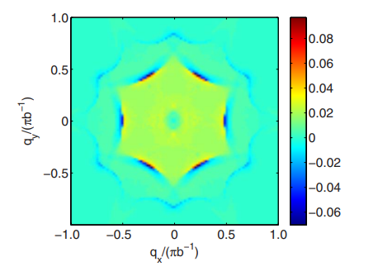
Top: Figure (6) reproductions with N = 128, 400 grids respectively.
Bottom: Original Figure (5)(b).

Slide 7
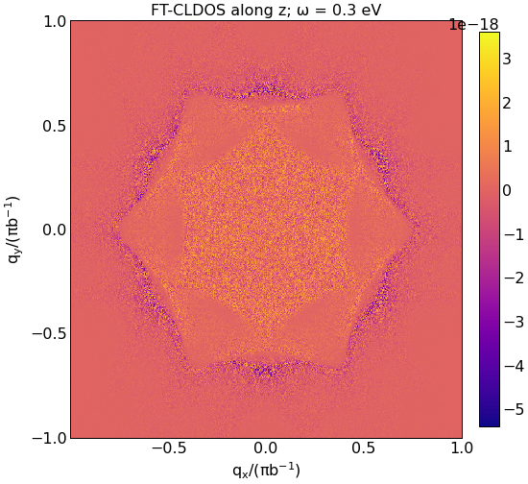
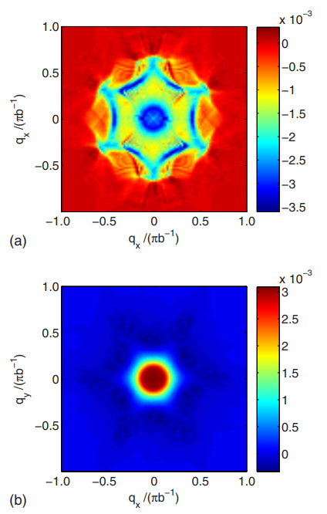
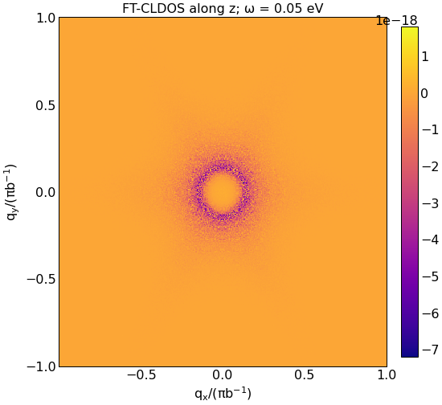
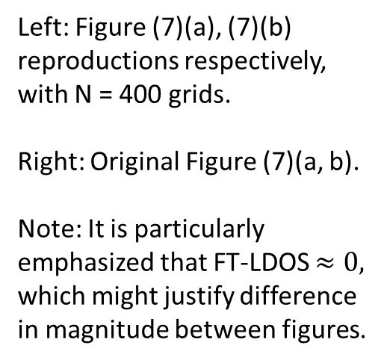
Left: Figure (7)(a), (7)(b) reproductions respectively, with N = 400 grids.
Right: Original Figure (7)(a, b).
Note: It is particularly emphasized that FT-LDOS $≈0,$ which might justify difference in magnitude between figures.

Slide 8
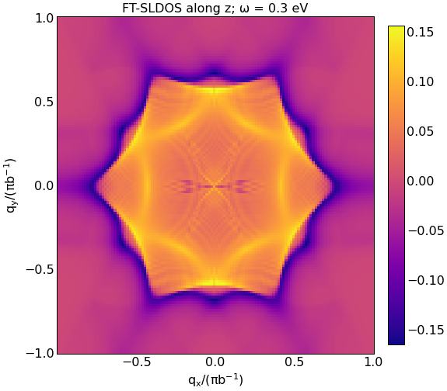

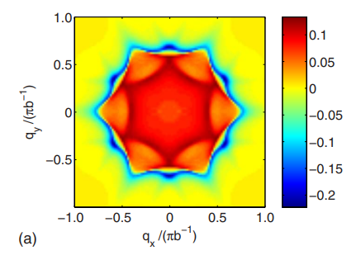
Top: Figure (8)(a) reproductions with N = 128, 400 grids respectively.
Bottom: Original Figure (5)(b).

Slide 9
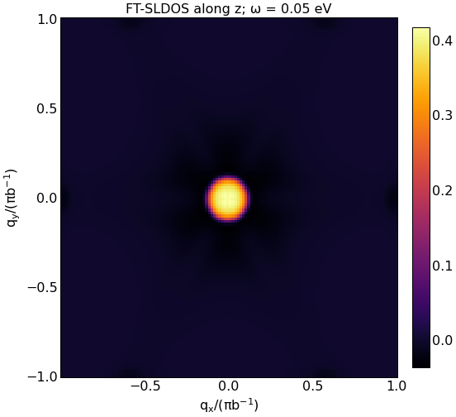

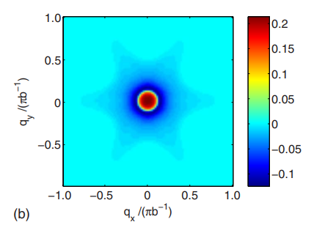
Top: Figure (8)(b) reproductions with N = 128, 400 grids respectively. Hexagonal warping appears to be present, but opacity is an issue towards visualizing it.
Bottom: Original Figure (5)(b).

Slide 10
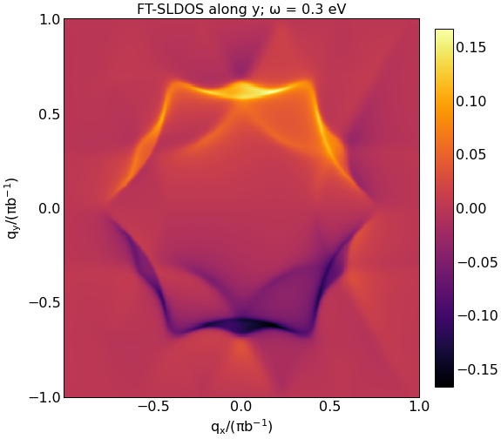
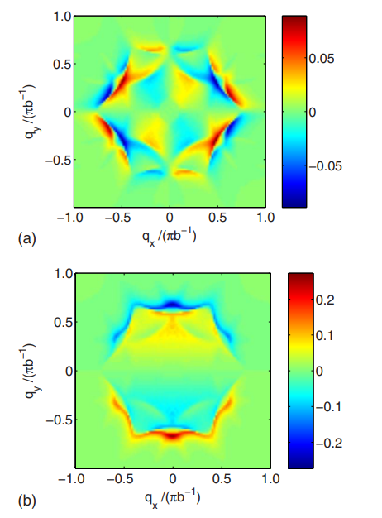
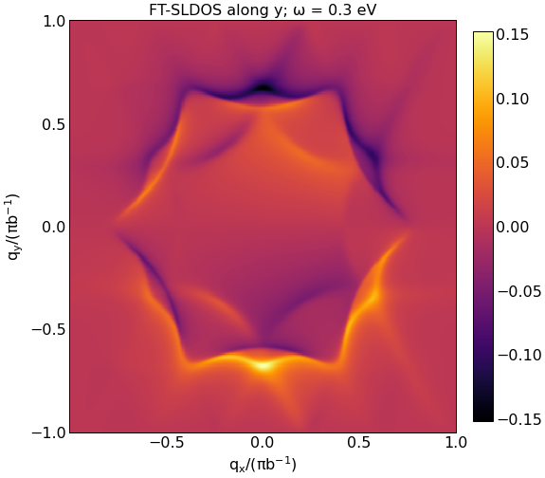
Left: Figure (9) reproductions (real, and imaginary parts respectively) with N = 400 grids.
Right: Figure 9 original (real, and imaginary respectively).
FT-SLDOS calculations seem by far to be the least accurate.

Slide 11
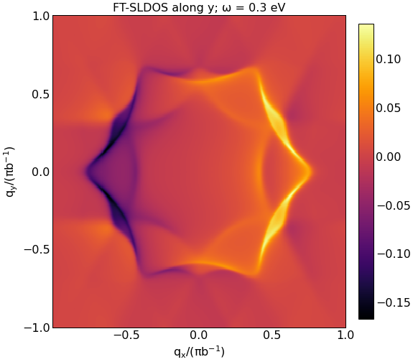
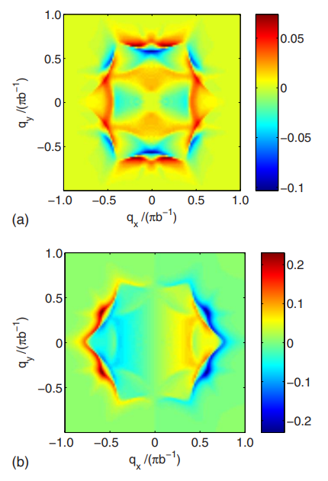
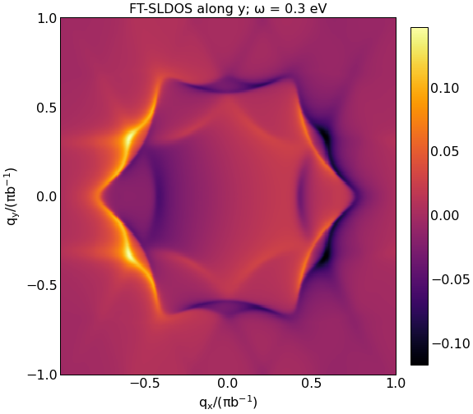
Left: Figure (10) reproductions (real, and imaginary parts respectively) with N = 400 grids.
Right: Figure 10 original (real, and imaginary respectively).

